Slide 1





Persistence
Working with the Filesystem,
MongoDB and Mongoose
Files
MongoDB
SoftUni Team
Technical Trainers
Software University
http://softuni.bg

Slide 2

Table of Contents
Node.js Filesystem
Relational and Non-Relational Databases
MongoDB and Mongoose Overview
Mongoose Models
CRUD with Mongoose
Mongoose Querying

Slide 3
Have a Question?
sli.do #js-web

Slide 4
Working with the File System
The fs module gives you access to the file system
All functions have synchronous and asynchronous variants
let fs = require('fs');
This operation blocks
the event loop
let data = fs.readFileSync('./package.json', 'utf8');
console.log(data);
Asynchronous callback
let data = fs.readFile('./package.json', 'utf8', (err, data) => {
// Handle possible errors
console.log(data);
});

Slide 5
Working with the File System (2)
List files in a directory
let data = fs.readdirSync('./myDir', 'utf8');
console.log(data);
let data = fs.readdir('./myDir', 'utf8', (err, data) => {
if (err) {
console.log(err);
return;
}
console.log(data);
});
The result is an array of strings, containing all filenames

Slide 6
Working with the File System (3)
Create a directory
fs.mkdirSync('./myDir');
fs.mkdir('./myDir', err => {
if (err) {
console.log(err);
return;
}
});

Slide 7
Working with the File System (4)
Rename file or directory
fs.renameSync('./oldName', './newName');
fs.rename('./oldName', './newName', err => {
if (err) {
console.log(err);
return;
}
});

Slide 8
Working with the File System (5)
Write a file
const fs = require('fs');
let filePath = './data.txt';
let data = 'Some text';
Default encoding is utf8
fs.writeFileSync(filePath, data);
fs.writeFile(filePath, data, err => {
if (err) {
console.log(err);
return;
}
});

Slide 9
Working with the File System (6)
Delete file
fs.unlinkSync('./target.txt');
fs.unlink('./target.txt', err => {
if (err) {
console.log(err);
return;
}
});

Slide 10
Working with the File System (7)
Delete directory
Full API docs: https://nodejs.org/api/fs.html
fs.rmdirSync('./myDir');
fs.rmdir('./myDir', err => {
if (err) {
console.log(err);
return;
}
});

Slide 11

Persistence Demo
Web server with file storage

Slide 12
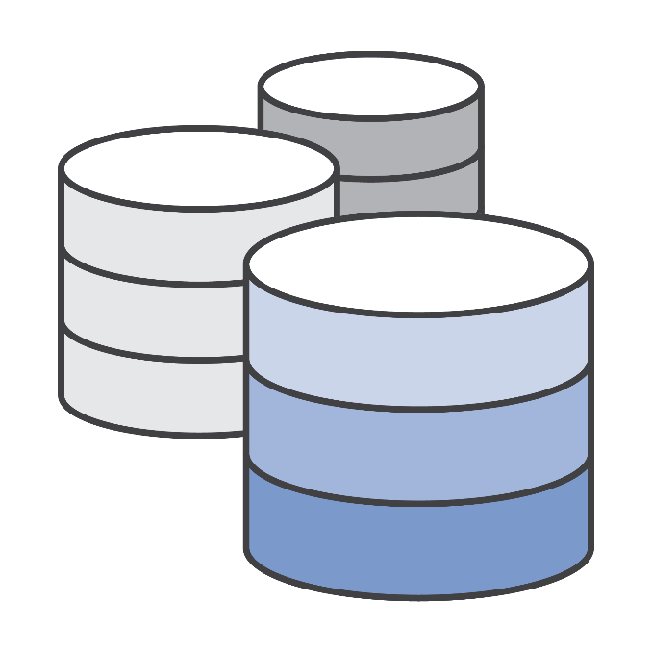

Relational and NoSQL Databases
VS
Differences and Examples

Slide 13
Relational Database
Organize data into one or more tables of columns and rows
Unique key identifying each row of data
Almost all relational databases use SQL to extract data
Relations between tables are done using Foreign Keys (FK)
Such databases are Oracle, MySQL, SQL Server, etc..
SELECT * FROM Students

Slide 14
Relational Database - Example
Table Pets
Table People
Id
Id
Name
Name
Age
Age
Color
Height
OwnerId
Email
Foreign Key

Slide 15
Non-relational Database (NoSQL)
Key-value stores
SQL query is not used in NoSQL systems
More scalable and provide superior performance
Such databases are MongoDB, Cassandra, Redis, etc..
{
ObjectId("59d3fe7ed81452db0933a871"),
"email": peter@gmail.com,
"age": 22
}

Slide 16


MongoDB Overview
Installation, Configuration, Startup

Slide 17
Install MongoDB
Download from: https://www.mongodb.com/download-center
When installed, MongoDB needs a driver
One to use with Node.js, .NET, Java, etc..
Install MongoDB driver for Node.js:
npm install mongodb -g

Slide 18
Configure MongoDB
Additional configurations are needed:
Go to installation folder and run a command prompt as an administrator
Type the following command:
Additional information at: https://docs.mongodb.com/manual/tutorial/install-mongodb-on-windows/
Usually in C:\Program Files\MongoDB\Server\3.4\bin
"path to mongod.exe" mongod --dbpath "path to store data"

Slide 19
Run MongoDB as a Windows Service
Instead of always opening a CMD we can run MongoDB as a service
After that just type 'net start MongoDB' and the database now runs as a service
Additional information: https://www.mkyong.com/mongodb/how-to-run-mongodb-as-windows-service/
mongod -–dbpath "C:\mymongodb" –-logpath "C:\mymongodb\logs.txt" –-install –-serviceName "MongoDB"

Slide 20
Working with MongoDB Shell Client
Shows all databases in data folder
Start the shell from another CLI
Type the command mongo
Additional information at: https://docs.mongodb.com/manual/reference/mongo-shell/
show dbs
use mytestdb
db.mycollection.insert({"name":"George"})
db.mycollection.find({"name":" George"})
db.mycollection.find({})
Gets all entries in database

Slide 21
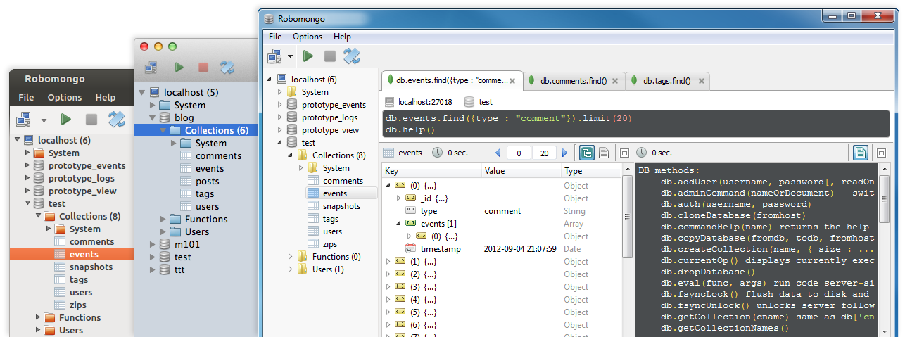
Working with MongoDB GUI
Choose one of the many
For example:
Robomongo -> https://robomongo.org/download
MongoBooster -> https://mongobooster.com/downloads

Slide 22
Visual Studio Code Intellisense
Install typings globally
Run the following to install MongoDB IntelliSense
The same can be used for all other modules with IntelliSense
npm install typings --global
typing install mongodb --save
typing install express --save

Slide 23
Working with MongoDB from Node.js - Example
const mongodb = require('mongodb')
let connectionStr = 'mongodb://localhost:27017/testdb'
mongodb.MongoClient.connect(connectionStr, (err, db) => {
let people = db.collection('people')
people.insert({ 'name': 'Pavel' }, (err, result) => {
people.find({ name: 'Ivan' }).toArray((err, data) => {
console.log(data)
})
})
})
Connection string to database
Loads all data into the RAM

Slide 24

Mongoose Overview
Installation, Models, Schema

Slide 25
Mongoose Overview
Mongoose is a object-document model module in Node.js for MongoDB
It provides a straight-forward, schema-based solution to model your application data.
Includes build-in type casting and validation
Extends the native queries (much easier to use)
To install type in CMD:
npm install mongoose --g

Slide 26
Working with Mongoose in Node.js
Load the following module:
Connecting to the database:
Create models/schemas and store their data:
const mongoose = require('mongoose')
mongoose.connect('mongodb://localhost:27017/unidb')
let Student = mongoose.model('Student', { type: String })
let studentEntity = new Student('Petar')
studentEntity.save(callback) // Save to Database

Slide 27
Working with Mongoose - Example
let Student = mongoose.model('Student', {
firstName: { type: String, required: true },
lastName: { type: String, required: true },
facultyNumber: { type: String, required: true, unique: true },
age: { type: Number }
})
mongoose.connect(connection).then(() => {
let firstStudent = new Student({ name: 'Kiril', lastName: 'Kirilov', facultyNumber: '13738'})
firstStudent
.then((sInfo) => console.log(sInfo))
.catch((err) => console.warn(err))
})
Age not required

Slide 28
Working with Mongoose – Example 2
let Course = mongoose.model('Course', {
name: { type: String, required: true, index: true },
isOpen: { type: Boolean, required: true },
students: [Student.schema]
}) let math = new Course({name: 'Math for Dummies',
isOpen: true, students: [ firstStudent, secondStudent ]})
math
.save()
.then(course => {
console.log(course)
})
.catch(err => {
console.warn(err)})

Slide 29

MongoDB Hosting
Host a database in the largest MongoDB cloud service
Go to 'mLab' and register -> https://mlab.com/
You can store up to 500 MB of content

Slide 30

Mongoose Models
Constructor, Virtual Properties, Validation

Slide 31
Mongoose Models
Mongoose supports models
Fixed types of documents
Used like object constructors
Needs a mongoose.Schema call
let modelSchema = new mongoose.Schema({
propString: String,
propNumber: Number,
propObject: {},
propArray: [],
propBool: Boolean
})
let Model = mongoose.model('Model', modelSchema)

Slide 32
Model Methods
Since mongoose models are just JavaScript object constructors they can have methods
And these methods can be added to a schema
Use a different syntax than plain JS
Avoid arrow functions
let studentSchema = new mongoose.Schema({…})
studentSchema.methods.getInfo = function(){
return `I am ${this.firstName} ${this.lastName}`
}
let student = new Student({ … } )
console.log(student.getInfo())

Slide 33
Model Virtual Properties
Yet, not all properties need to be persisted to the database
Mongoose provides a way to create properties, that are accessible on all models, but are not persisted to the database
And they have both getters and setters
studentSchema.virtual('fullName').get(function () {
return this.firstName + ' ' + this.lastName
})

Slide 34
Property Validation
With Mongoose developers can define custom validation on their properties
Validate records when trying to save
studentSchema.path('firstName').validate(function () {
return this.firstName.length >= 2 && this.firstName.length <= 10
}, 'First name must be between 2 and 10 symbols long!')
Error message as second param

Slide 35
Exporting Modules
Having all model definitions in the main module is no good
That is the reason Node.js has modules in the first place
In folder models, file Student.js:
const mongoose = require('mongoose')
const studentSchema = new mongoose.Schema({
firstName: { type: String, required: true },
lastName: { type: String, required: true },
facultyNumber: { type: String, required: true, unique: true },
age: { type: Number }
})
module.exports = mongoose.model('Student')

Slide 36
Using Modules
We can put each model in a different module, and load all models at start
Where it is needed:
let Cat = require('./models/Cat')

Slide 37

CRUD with Mongoose
Create, Read, Update, Delete

Slide 38
CRUD with Mongoose
Mongoose supports all CRUD operations
Create (Persist data)
Read (Extract data)
studentObj.save(callback)
Student.find({}).exec()
Use the constructor

Slide 39
CRUD with Mongoose
Update (Modify data)
Delete (Remove data)
Student.findById(id, callback)
Student.findByIdAndUpdate(id, {$set: {prop: newVal}}, callback)
Student.update({_id: id, {$set: {prop: newVal}}, callback)
Student.findByIdAndRemove(id, callback)
Student.remove({name: studentName})

Slide 40
Create Example
let mongoose = require('mongoose')
mongoose.Promise = global.Promise
let connectionStr = 'mongodb://localhost:27017/unidb'
let studentSchema = new mongoose.Schema({
name: { type: String, required: true, minlength: 3 },
age: Number
})
let Student = mongoose.model('Student', studentSchema)
mongoose.connect(connectionStr).then(() => {
new Student({ name: 'Petar', age: 21 }).save()
.then(student => {
console.log(student._id)
})
})

Slide 41
Read Example
Student
.find({})
.exec()
.then(students => console.log(students))
Student
.find({name: 'Petar'})
.exec()
.then(students => console.log(students))
Student
.findOne({name: 'Petar'})
.exec()
.then(student => console.log(student))
Can return multiple
Returns only one

Slide 42
Update Example
Student
.findById('57fb9fe1853ab747b0f692d1')
.exec()
.then(student => { student.firstName = 'Stamat'
student.save()
})
Student
.findByIdAndUpdate('57fb9fe90cd76e4e2c59e1a2', {
$set: { name: 'Stamat' }
})
.exec()
Student
.update(
{ firstName: 'Kiril' },
{ $set: { name: 'Stamat' } },
{ multi: true })
.exec()

Slide 43
Remove Example & Count Example
Student
.findByIdAndRemove('57fb9fe1853ab747b0f692d1')
.exec()
Student
.remove({ name: 'Stamat' })
.exec()
Student
.count()
.exec()
.then(console.log)
Student
.count({ age: { $gt: 19 } })
.exec()
.then(console.log)

Slide 44

Mongoose Queries
Chaining

Slide 45
Mongoose Queries
Mongoose defines all queries of the native MongoDB driver in a more clear and useful way
Instead of:
Do:
{
$or: [
{conditionOne: true},
{conditionTwo: true}
]
}
.where({ conditionOne: true }).or({ conditionTwo: true })

Slide 46
Mongoose Queries Example
Mongoose supports many queries:
For equality/non-equality
Selection of some properties
Student.findOne({'lastName':'Kirilov'})
Student.find({}).where('age').gt(7).lt(14)
Student.find({}).where('facultyNumber').equals('12399')
Student.findOne({'lastName':'Kirilov'}).select('name age')

Slide 47
Mongoose Queries Example 2
Sorting
Limit & skip
Different methods could be stacked one upon the other
Student.find({}).sort({age:-1})
Student.find({}).sort({age:-1}).skip(10).limit(10)
Student.find({}).where('firstName').equals('gosho').where('age').gt(18).lt(65).sort({age:-1}).skip(10).limit(10)

Slide 48
Mongoose Queries Additional
All queries are executed over the object returned by Model.find()
Call .exec() at the end to run the query
Since mongoose 4 the '.then()' function is also supported
Student.findOne({'lastName':'Pesho'}).exec(callback)
Student.findOne({'lastName':'Pesho'}).then((data)=>{})

Slide 49
Summary
NoSql databases provide superior performance
Mongoose gives us a schema-based solution
Mongoose supports all CRUD operations
Chaining queries with Mongoose is possible
let modelSchema = new mongoose.Schema({
propString: String })
let Model = mongoose.model('Model', modelSchema)
Student.find({}).where('firstName').equals('gosho').where('age').gt(18).lt(65).sort({age:-1}).skip(10).limit(10)

Slide 50












Files and MongoDB
https://softuni.bg/trainings/courses/

Slide 51





Trainings @ Software University (SoftUni)
Software University – High-Quality Education, Profession and Job for Software Developers
softuni.bg
Software University Foundation
http://softuni.foundation/
Software University @ Facebook
facebook.com/SoftwareUniversity
Software University Forums
forum.softuni.bg

